Slide 1


Azure Service Bus: A Comprehensive Overview
This presentation will explore the key features, benefits, and use cases of Azure Service Bus, a powerful cloud messaging service that empowers developers to build robust, scalable, and reliable applications.
JS
by JAYANTH B S

Slide 2
What is Azure Service Bus?
Azure Service Bus is a fully managed, cloud-based messaging service for sending and receiving messages between applications.
It provides a reliable and scalable platform for decoupling applications, enabling asynchronous communication, and handling message queues.

Slide 3
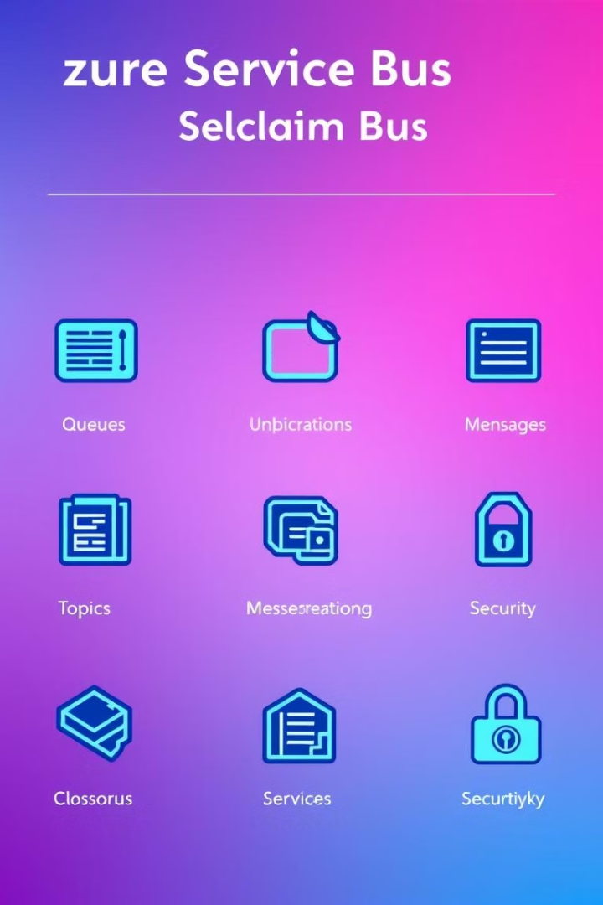
Key Features of Azure Service Bus
Queues
Topics
Point-to-point messaging where each message is delivered to only one receiver.
Publish-subscribe messaging where messages are published to a topic and multiple subscribers can receive them.
Message Sessions
Dead-letter Queues
Allowing a single receiver to process multiple messages in a specific order, ensuring atomicity and consistency.
Handle messages that fail to be processed successfully, enabling retries and error handling.

Slide 4




Messaging Patterns Supported by Azure Service Bus
Request-Reply
Publish-Subscribe
Enables synchronous communication between applications.
Allows multiple subscribers to receive messages from a single publisher.
Queue-Based Messaging
Provides reliable and asynchronous message delivery.

Slide 5

Benefits of Using Azure Service Bus
Scalability
Reliability
Handles massive message volumes with ease, scaling automatically to meet demand.
Ensures message delivery even in the face of network failures or application outages.
Security
Integration
Provides robust security features including authentication, authorization, and message encryption.
Integrates seamlessly with other Azure services and popular programming languages.

Slide 6

Scenarios Where Azure Service Bus Can Be Used
Microservices communication, enabling communication between different components of an application.
E-commerce order processing, handling order updates and notifications.
1
2
3
4
Real-time data streaming, delivering data from sensors or IoT devices.
Event-driven architectures, responding to events and triggers in a scalable and asynchronous manner.

Slide 7
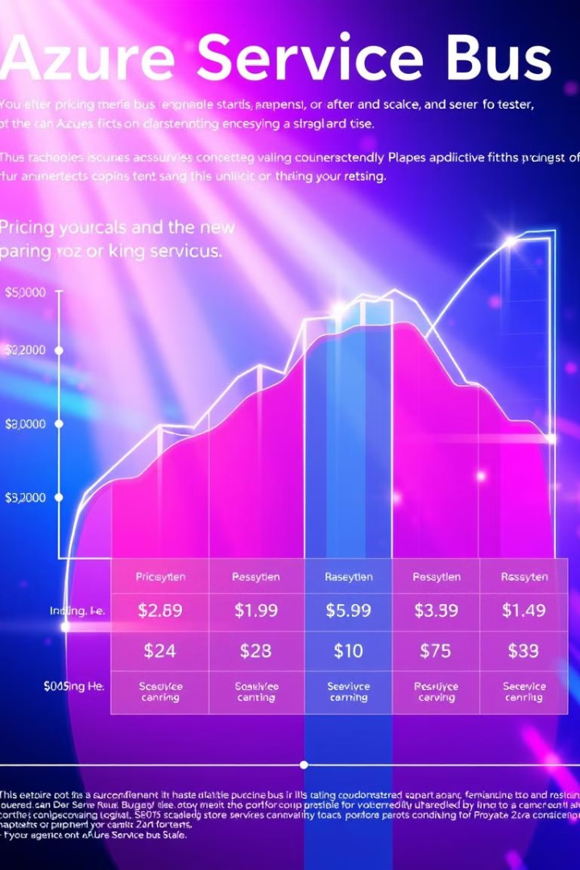
Pricing and Scaling of Azure Service Bus
1
2
Pay-as-you-go
Reserved Units
Pricing based on message throughput, storage, and other factors.
Pre-purchase units for cost savings with predictable message volumes.
3
Automatic Scaling
Scales automatically based on message volume to ensure performance.

Slide 8

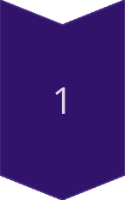
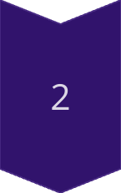
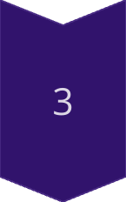
Security and Compliance Considerations
Data encryption at rest and in transit.
Role-based access control (RBAC) for fine-grained authorization.
Compliance with industry standards such as HIPAA, GDPR, and SOC 2.

Slide 9




Integration with Other Azure Services
Azure Functions
1
Serverless compute for event-driven processing.
Logic Apps
2
Automated workflows for connecting applications and services.
Event Hubs
3
Real-time ingestion and processing of high-volume data streams.
Azure Cosmos DB
4
Globally distributed multi-model database for storing messages.

Slide 10
Azure Service Bus Use Cases and Examples
E-commerce
1
Order processing, inventory management, and customer notifications.
IoT
2
Collecting and processing data from connected devices.
Microservices
3
Decoupling and communication between independent services.
Event-Driven Architectures
4
Reacting to events and triggers in a scalable and asynchronous manner.

